Slide 1


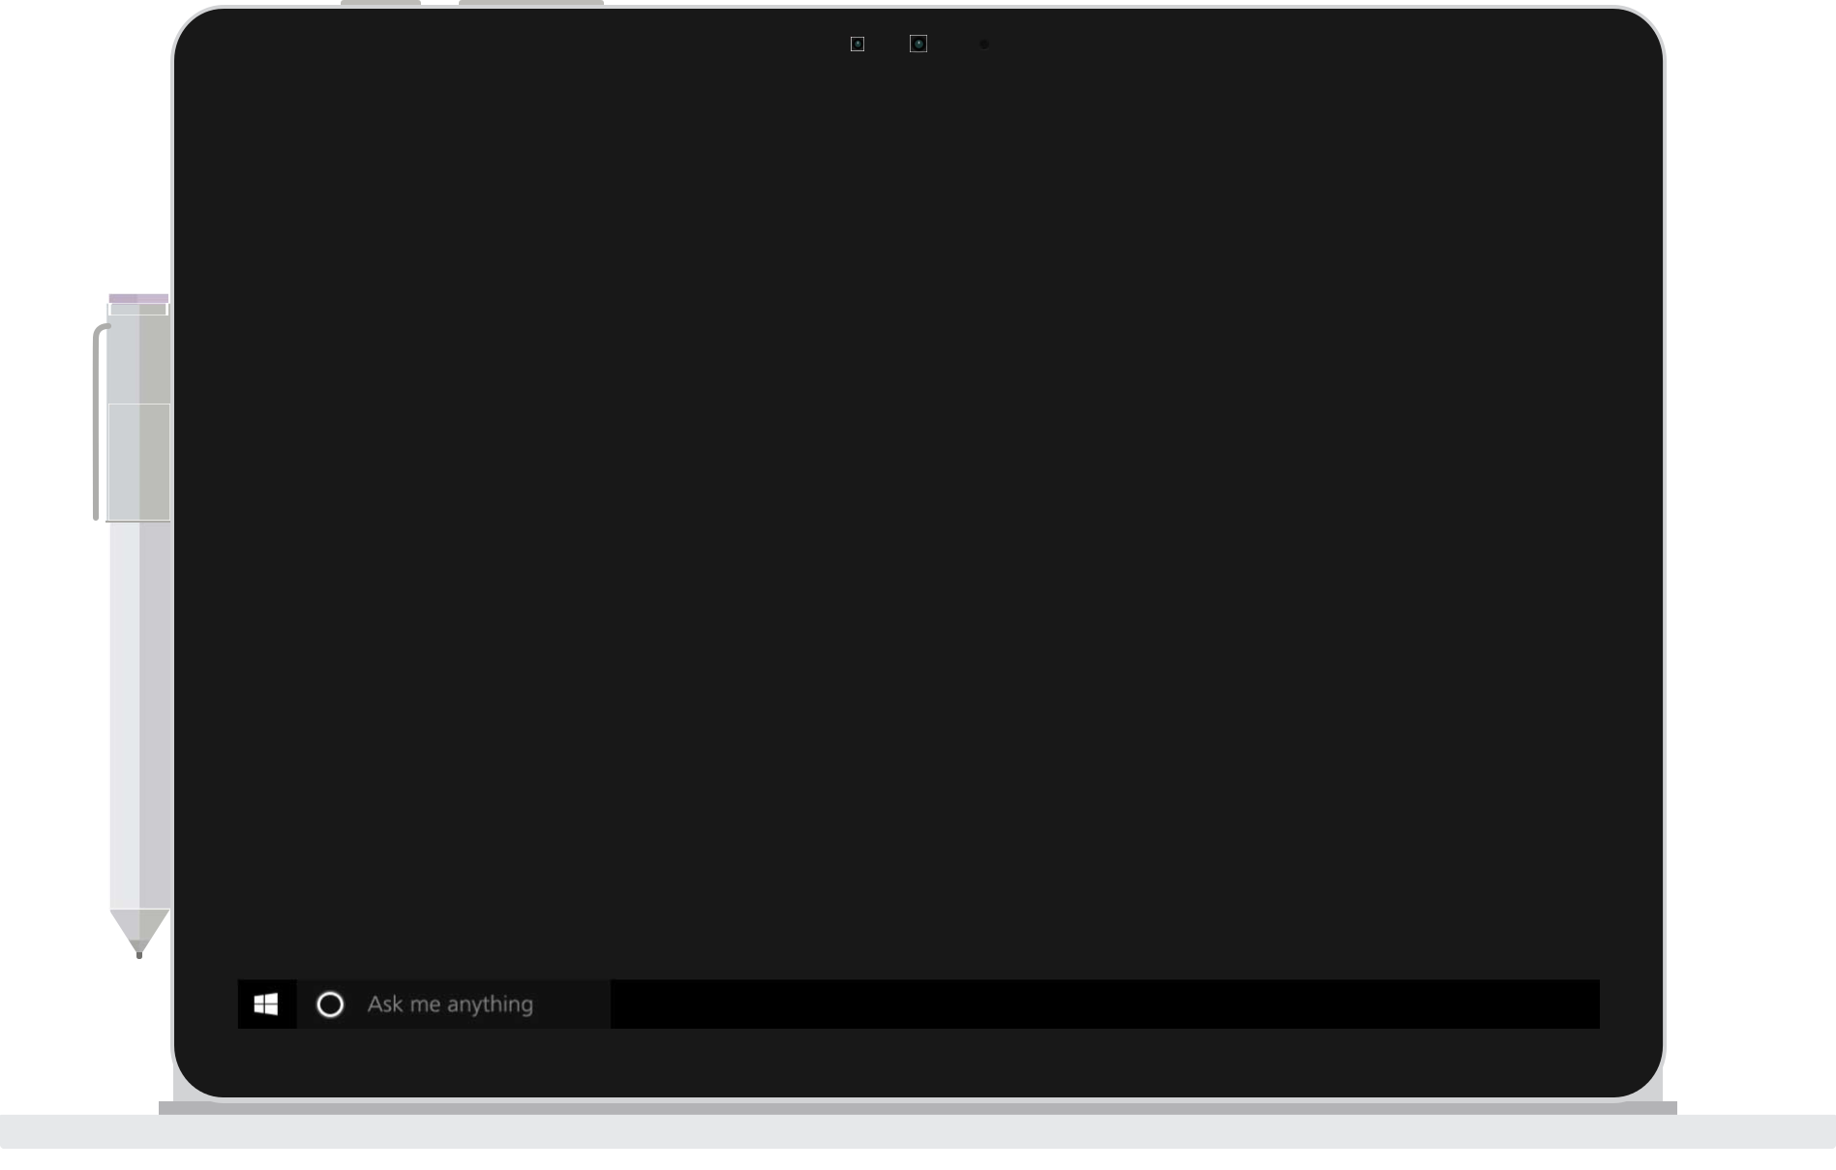
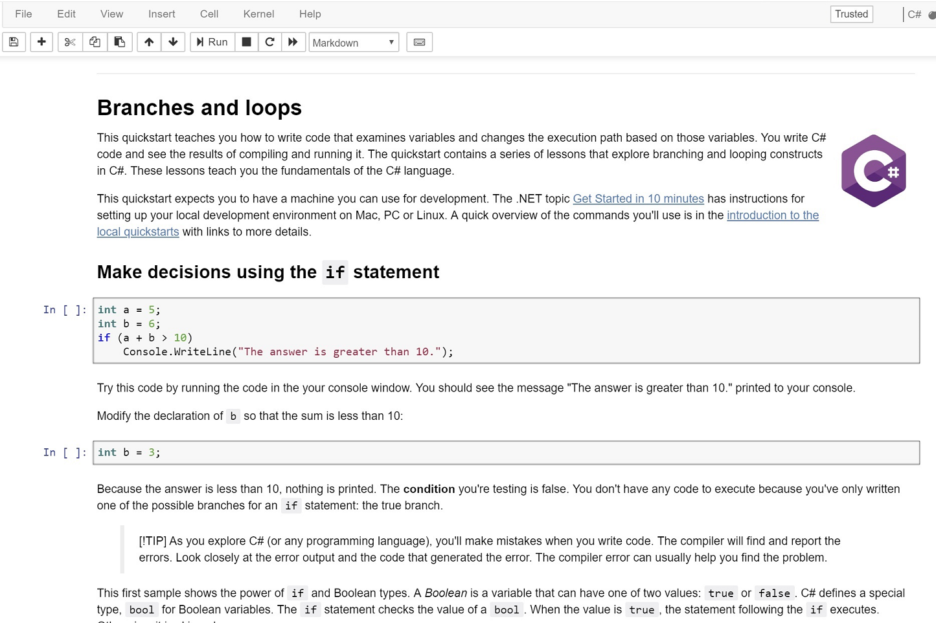
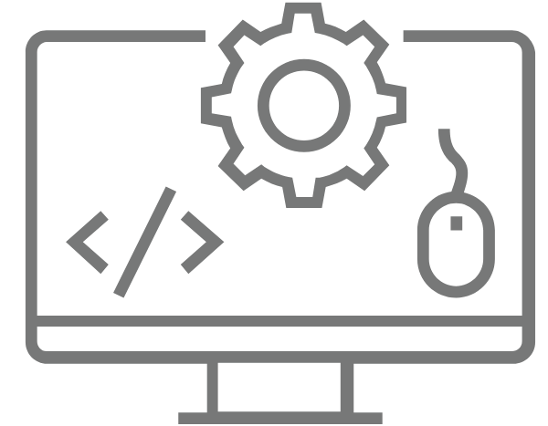




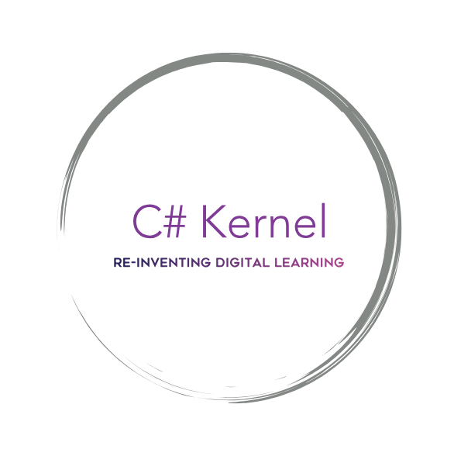
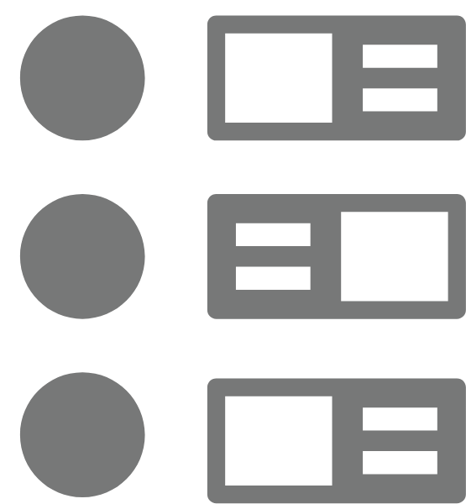


Developers:
M. Abdelmagid,
A. Bharath,
M. Hagras,
M. Hussein,
A. Liaskas,
O. Oguz,
Z. Zhang
TIMELINE
PRODUCT
”The first Azure Notebook that provides an execution environment for C#."
Deployment
https://github.com/MohamedEihab/icsharp.git
Implementation
Integration & Testing
Target Audience Survey
Planning
Requirements
& Specification
https://docs.google.com/spreadsheets/d/1bC1vOH3DygQt2cwDeenTAhpfKBB6gpHkJ_B01fQLIr8/edit?usp=sharing
z
TECHNOLOGIES
SOLUTION
“Interactive C# coding in your browser”
FRONT-END
AZURE NOTEBOOKS
IntelliSense
LANGUAGES
JUPYTER NOTEBOOKS
Context-aware code completion that speeds up the coding process by reducing typos and providing seamless class introspection.
CSS
C# KERNEL FRONTEND
JAVASCRIPT
C#
PYTHON
C# KERNEL BACKEND
MULTI PLATFORM
ROSLYN SCRIPTING API
WEB BROWSER
Error Display
Syntax Highlighting
WINDOWS
Display errors made by the user on the notebook. This feature helps the user identify and learn from syntax mistakes.
Syntax highlighting improves the readability of the text making it user friendly whist coding.
MAC OS
LINUX
BACK-END

